Slide 1
NT219- Cryptography
Week 7: Modern Asymmetric Ciphers
PhD. Ngoc-Tu Nguyen
tunn@uit.edu.vn

Slide 2
Outline
Why asymmetric cryptography?
Factoring Based Cryptography (P1)
Logarithm Based Cryptography (P2)
ElGamal cipher;
Diffie-Hellman key exchange;
Elliptic Curve Cryptography (P3)
Some advanced cryptography system (quantum resistance)
Publick key: https://www.vietcombank.com.vn ???
Notes:
Cipher=a secret system of writing;

Slide 3
Why Public-Key Cryptosystems?
To overcome two of the most difficult problems associated with symmetric encryption:
Key distribution (key for sysmetric encryption)
How to have secure communications in general without having to trust a K D C with your key
Digital signatures
How to verify that a message comes intact from the claimed sender
Whitfield Diffie and Martin Hellman: proposed a method that addressed both problems (1976)

Slide 4
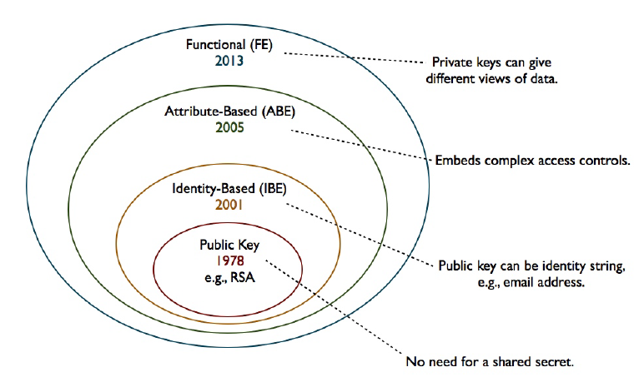





Moden Asymmetric ciphers
Symmetric cipher vs Asymmetric cipher
Hommophic, Searchable encryption,..
$ID_{A}(atributes)$
$ID_{B}(atributes)$
$$(PK_{A}, \{SK_{A},SK_{B},..\})$$
ID
$$(PK_{A}, SK_{A})$$
$$(PK_{A}, SK_{A})$$

Slide 5
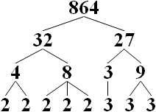
Prime factorization problem
Factorize number
N = 864
= 2⁵ × 3³
Input: n-bits composite number N
Output:
No classical algorithm has been published that can factor all integers in polynomial time.
https://en.wikipedia.org/wiki/Integer_factorization

Slide 6
Prime factorization problem
“Prime factorization one-way function!”
Input: large prime number and a large number $e$
Easy to compute
$d=e^{−1}\operatorname{mod}{(}p−1)(q−1)$, e.d =1 mode (p-1)(q-1)
C = M ^{e} mod n
Input:
“Hard” to compute
C^{d} mod n=M^{e.d} mod n = M^{e.d mod(p-1)(q-1)} mod n = M

Slide 7
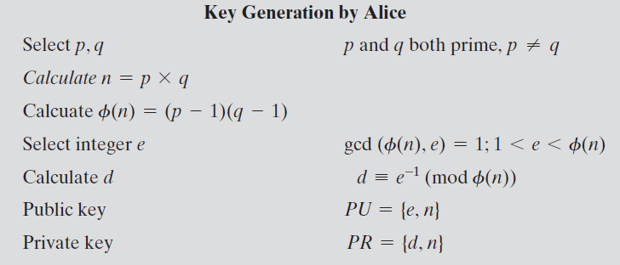
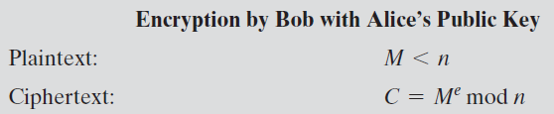
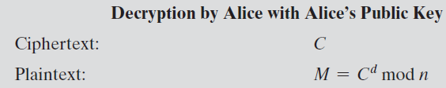

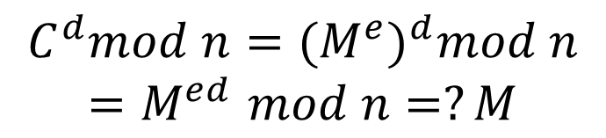
The R S A Algorithm
$$e.d=1 mod φ(n)$$
$$C^{d}mod n={{(M}^{e})}^{d}mod n$$
$${=M}^{ed}mod n=?M$$
Notes:
Figure 9.5 summarizes the RSA algorithm. It corresponds to Figure 9.1a: Alice
generates a public/private key pair; Bob encrypts using Alice’s public key; and Alice
decrypts using her private key.

Slide 8
R S A Algorithm
RSA makes use of an expression with exponentials
Plaintext is encrypted in blocks with each block having a binary value less than some number n
Encryption and decryption are of the following form, for some plaintext block M and ciphertext block C
C = Me mod n
M = C^{d} mod n = (Me)^{d} mod n = M^{ed} mod n
Both sender and receiver must know the value of n
The sender knows the value of e, and only the receiver knows the value of d
This is a public-key encryption algorithm with a public key of PU={e,n} and a private key of PR={d,n}

Slide 9
Algorithm Requirements
For this algorithm to be satisfactory for public-key encryption, the following requirements must be met:
It is possible to find values of e, d, n such that M^{ed} mod n = M for all M < n
It is relatively easy to calculate Me mod n and C^{d} mod n for all values of M < n
It is infeasible to determine d given e and n
Notes:
For this algorithm to be satisfactory for public-key encryption, the following requirements
must be met.
1. It is possible to find values of e, d, and n such that M^{ed} mod n = M for all M < n .
2. It is relatively easy to calculate Me mod n and C^{d} mod n for all values of M < n .
3. It is infeasible to determine d given e and n .

Slide 10
Exponentiation in Modular Arithmetic
Both encryption and decryption in RSA involve raising an integer to an integer power, mod n
Can make use of a property of modular arithmetic:
[(a mod n) x (b mod n)] mod n =(a x b) mod n
With RSA you are dealing with potentially large exponents so efficiency of exponentiation is a consideration
Notes:
Both encryption and decryption in RSA
involve raising an integer to an integer power, mod n . If the exponentiation is done
over the integers and then reduced modulo n , the intermediate values would be
gargantuan. Fortunately, as the preceding example shows, we can make use of a
property of modular arithmetic:
[(a mod n ) * (b mod n )] mod n = (a * b ) mod n
Thus, we can reduce intermediate results modulo n . This makes the calculation
practical.
Another consideration is the efficiency of exponentiation, because with RSA,
we are dealing with potentially large exponents. To see how efficiency might be increased,
consider that we wish to compute x¹⁶ . A straightforward approach requires
15 multiplications:
x¹⁶ = x * x * x * x * x * x * x * x * x * x * x * x * x * x * x * x
However, we can achieve the same final result with only four multiplications if we
repeatedly take the square of each partial result, successively forming (x² , x⁴ , x⁸ , x¹⁶ ).

Slide 11
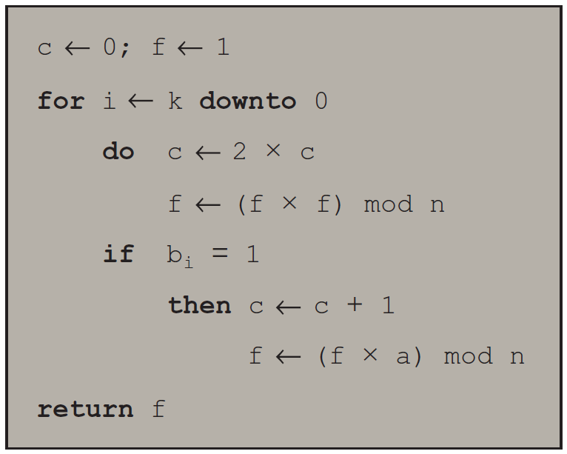

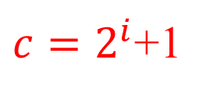


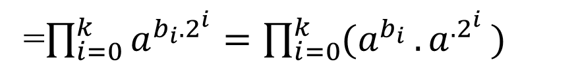
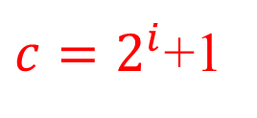
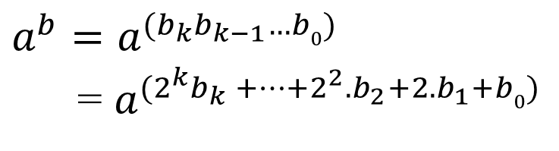

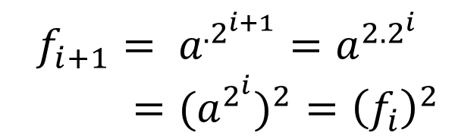

Algorithm for Computing a^{b} mod n
Note: The integer b is expressed as a binary number $b=b_{k}b_{k−1}…b0$
$$a^{b}=a^{(b_{k}b_{k−1}…b0)}$$
= $a^{(2^{k}b_{k} +…+2^{2}.b_{2}+2.b_{1}+b0)}$
=$\prod_{i=0}^{k}{a^{b_{i}.2^{i}}}=\prod_{i=0}^{k}{{(a}^{b_{i} }{.a}^{.2^{i}})}$
$$c=2^{i}$$
$$c=2^{i}$$
$${f_{i}=a}^{.2^{i}}$$
$c=2^{i}$+1
$${f_{i}=a}^{c}$$
$c=2^{i}$+1
$${f_{i+1}= a}^{.2^{i+1}}=a^{{2.2}^{i}}$$
$={{(a}^{2^{i}})}^{2}={\left(f_{i}\right)}^{2}$
$$f_{i+1}={\left(f_{i}\right)}^{2}.a$$
Notes:
We can therefore develop the algorithm for computing a^{b} mod n, shown in
Figure 9.8.

Slide 12
Efficient Operation Using the Public Key
To speed up the operation of the R S A algorithm using the public key, a specific choice of e is usually made
The most common choice is 65537 (2¹⁶ + 1)
Two other popular choices are e=3 and e=17
Each of these choices has only two 1 bits, so the number of multiplications required to perform exponentiation is minimized
With a very small public key, such as e = 3, R S A becomes vulnerable to a simple attack

Slide 13
Efficient Operation Using the Private Key
Decryption uses exponentiation to power d
A small value of d is vulnerable to a brute-force attack and to other forms of cryptanalysis
Can use the Chinese Remainder Theorem (C R T) to speed up computation
The quantities d mod (p – 1) and d mod (q – 1) can be precalculated
End result is that the calculation is approximately four times as fast as evaluating M = C^{d} mod n directly
Notes:
We cannot similarly choose a small constant value of d for efficient operation. A small value of d is vulnerable to a brute-force attack and to other forms of cryptanalysis [WIEN90]. However, there is a way to speed up computation using the CRT.
The quantities d mod (p - 1) and d mod (q - 1) can be precalculated. The end
result is that the calculation is approximately four times as fast as evaluating M = C^{d}
mod n directly [BONE02].

Slide 14
Key Generation
Before the application of the public-key cryptosystem each participant must generate a pair of keys:
Determine two prime numbers p and q
Select either e or d and calculate the other
Because the value of n = pq will be known to any potential adversary, primes must be chosen from a sufficiently large set
The method used for finding large primes must be reasonably efficient
Notes:
Before the application of the public-key cryptosystem, each
participant must generate a pair of keys. This involves the following tasks.
• Determining two prime numbers, p and q.
• Selecting either e or d and calculating the other.
First, consider the selection of p and q . Because the value of n = pq will be
known to any potential adversary, in order to prevent the discovery of p and q by
exhaustive methods, these primes must be chosen from a sufficiently large set (i.e.,
p and q must be large numbers). On the other hand, the method used for finding
large primes must be reasonably efficient.
At present, there are no useful techniques that yield arbitrarily large primes,
so some other means of tackling the problem is needed. The procedure that is generally
used is to pick at random an odd number of the desired order of magnitude
and test whether that number is prime. If not, pick successive random numbers until
one is found that tests prime.
A variety of tests for primality have been developed (e.g., see [KNUT98] for
a description of a number of such tests). Almost invariably, the tests are probabilistic.
That is, the test will merely determine that a given integer is probably prime.
Despite this lack of certainty, these tests can be run in such a way as to make the
probability as close to 1.0 as desired. As an example, one of the more efficient
and popular algorithms, the Miller-Rabin algorithm, is described in Chapter 2.
With this algorithm and most such algorithms, the procedure for testing whether
a given integer n is prime is to perform some calculation that involves n and a
randomly chosen integer a . If n “fails” the test, then n is not prime. If n “passes”
the test, then n may be prime or nonprime. If n passes many such tests with many
different randomly chosen values for a , then we can have high confidence that n
is, in fact, prime.

Slide 15
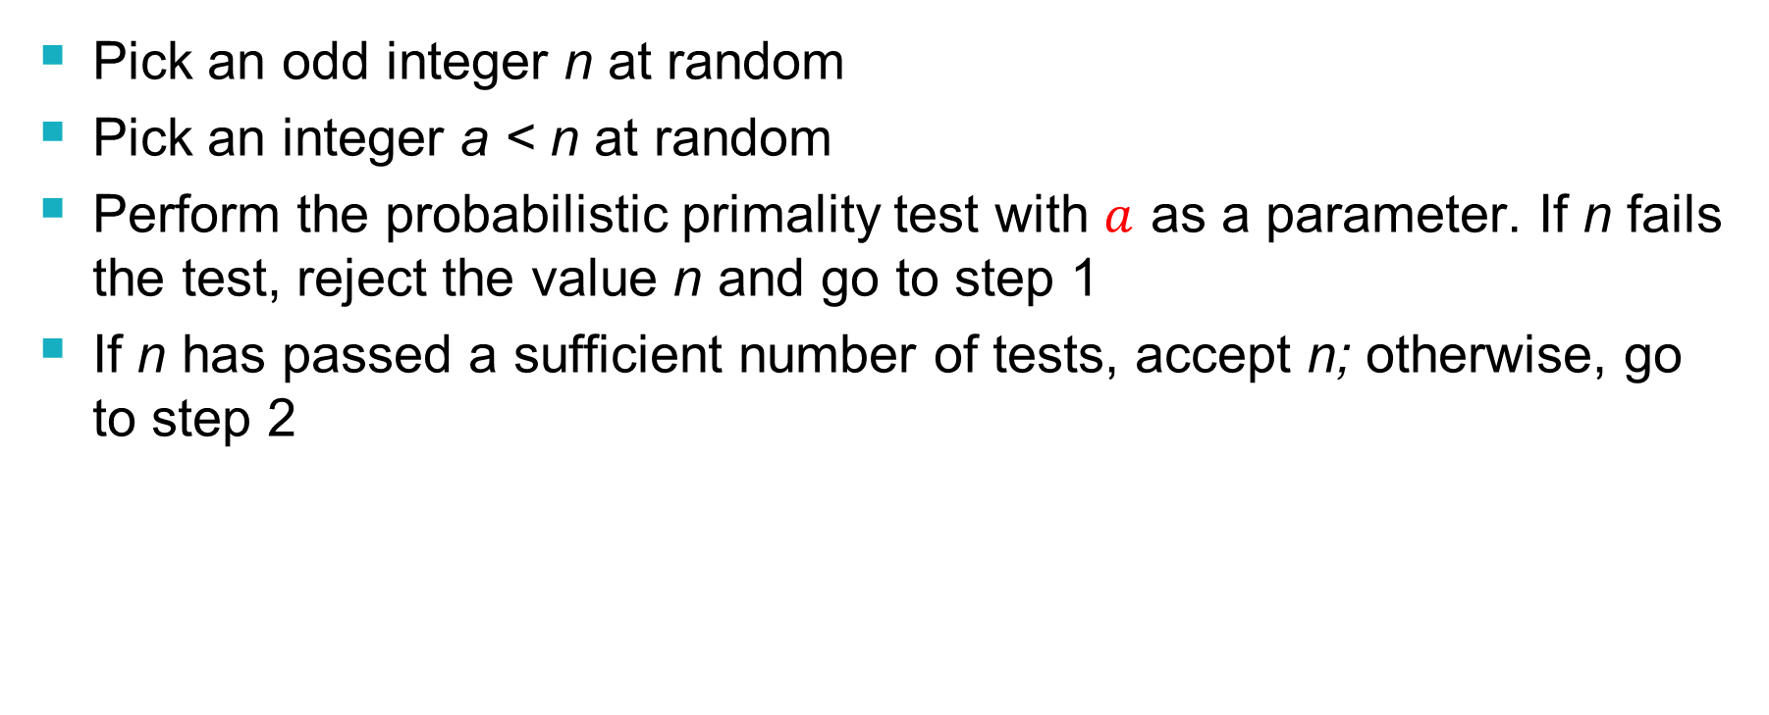
Procedure for Picking a Prime Number
Pick an odd integer n at random
Pick an integer a < n at random
Perform the probabilistic primality test with $a$ as a parameter. If n fails the test, reject the value n and go to step 1
If n has passed a sufficient number of tests, accept n; otherwise, go to step 2
Notes:
In summary, the procedure for picking a prime number is as follows.
1. Pick an odd integer n at random (e.g., using a pseudorandom number
generator).
2. Pick an integer a < n at random.
3. Perform the probabilistic primality test, such as Miller-Rabin, with a as a
parameter. If n fails the test, reject the value n and go to step 1.
4. If n has passed a sufficient number of tests, accept n ; otherwise, go to step 2.

Slide 16


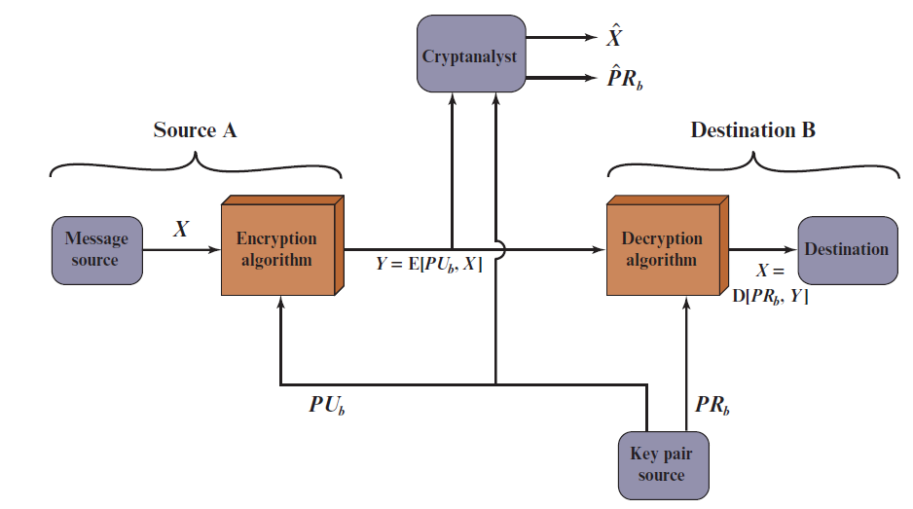
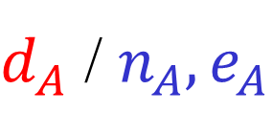


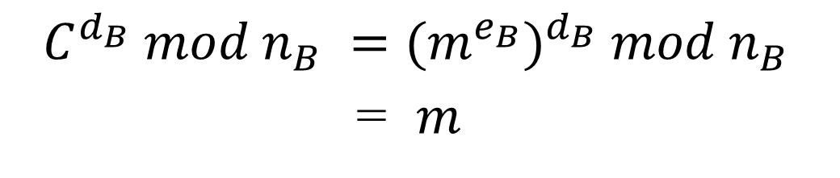

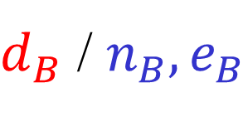
RSA: Confidentiality
A
B
$d_{A}$ / $n_{A}, e_{A}$
$d_{B}$ / $n_{B}, e_{B}$
$$e_{A}.d_{A}=1 mod φ(n_{A})$$
$$e_{B}.d_{B}=1 mod φ(n_{B})$$
$$C =m^{e_{B}} mod n_{B}$$
$$C^{d_{B}} mod n_{B} ={(m^{e_{B}})}^{d_{B}} mod n_{B}$$
= $m$
Protect secret key?
Distribute public keys?
Notes:
Let us take a closer look at the essential elements of a public-key encryption
scheme, using Figure 9.2 (compare with Figure 3.2).
The scheme illustrated in Figure 9.2 provides confidentiality.

Slide 17
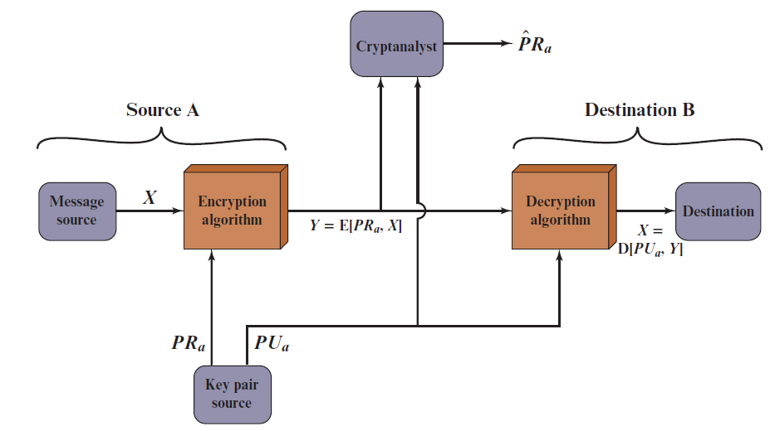


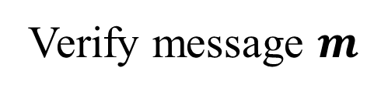
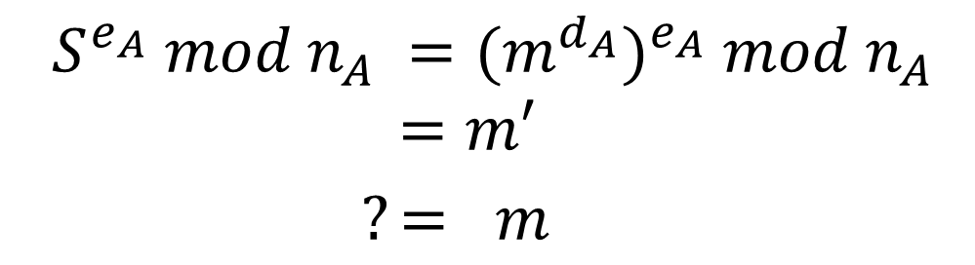
RSA: Authentication
A
B
$d_{A}$ / $n_{A}, e_{A}$
$d_{B}$ / $n_{B}, e_{B}$
$$S =m^{d_{A}} mod n_{A}$$
$$(m,S )$$
Verify message $m$
$$S^{e_{A}} mod n_{A} ={(m^{d_{A}})}^{e_{A}} mod n_{A}$$
$$=m′$$
$?= m$
Protect secret key?
Distribute public keys?
Sent by A
Original (integrity)
Notes:
Let us take a closer look at the essential elements of a public-key encryption
scheme, using Figure 9.2 (compare with Figure 3.2).
The scheme illustrated in Figure 9.2 provides confidentiality.

Slide 18
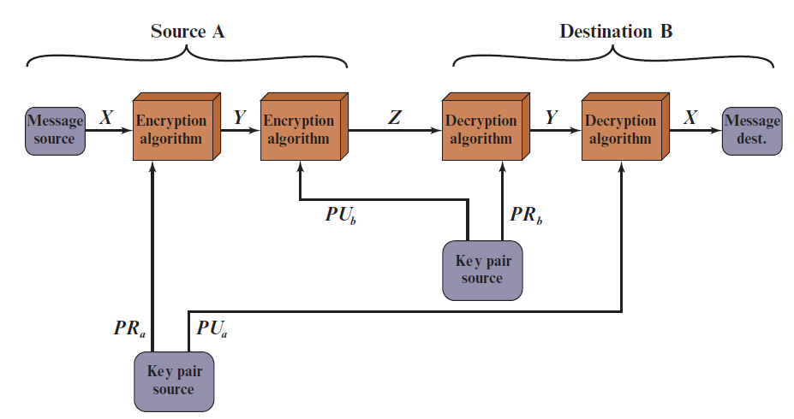


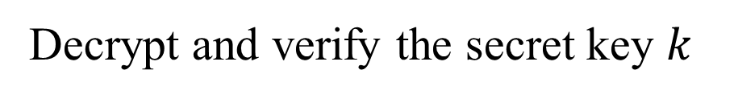
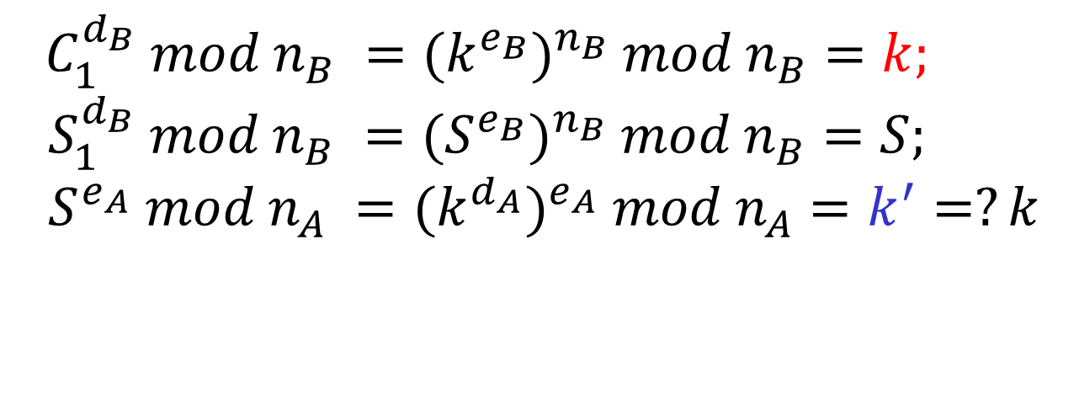
RSA: Authentication and Secrecy
A
B
$d_{A}$ / $n_{A}, e_{A}$
$d_{B}$ / $n_{B}, e_{B}$
$$S =k^{d_{A}} mod n_{A}$$
$$(C_{1}=k^{e_{B}},{S_{1}=S}^{e_{B}} )$$
Decrypt and verify the secret key $k$
$$C_{1}^{d_{B}} mod n_{B} ={(k^{e_{B}})}^{n_{B}} mod n_{B}=k;$$
$$S_{1}^{d_{B}} mod n_{B} ={(S^{e_{B}})}^{n_{B}} mod n_{B}=S;$$
$$S^{e_{A}} mod n_{A} ={(k^{d_{A}})}^{e_{A}} mod n_{A}=k^{′}=?k$$
Limitation?
Notes:
Let us take a closer look at the essential elements of a public-key encryption
scheme, using Figure 9.2 (compare with Figure 3.2).
The scheme illustrated in Figure 9.2 provides confidentiality.

Slide 19
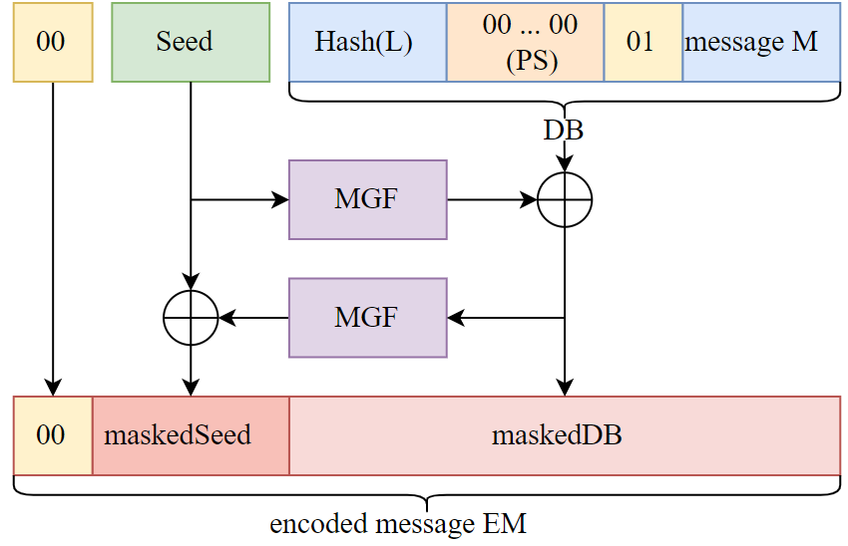


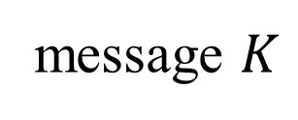
Encryption Using Optimal Asymmetric Encryption Padding (O A E P)
MGF: a hash function
$$K$$
message $K$
$$DB=H(L)||0000.. ||01||K$$
Y = MGF(Seed) ⊕ DB
X= MGF(Y) ⊕ Seed
?
X
Y

Slide 20
Outline
Why asymmetric cryptography?
Factoring Based Cryptography (P1)
Logarithm Based Cryptography (P2)
ElGamal cipher;
Diffie-Hellman key exchange;
Elliptic Curve Cryptography (P3)
Some advanced cryptography system (quantum resistance)
Notes:
Cipher=a secret system of writing;

Slide 21

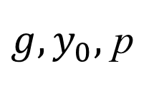


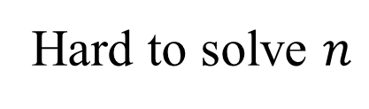
Discrete Logarithm problem
$$Finitemultiplicative group \left(G, .\right)=<g> =\{g^{n}:n∈ ℤ\}$$
AutoSeededRandomPool prng;
Integer p, q, g;
CryptoPP::PrimeAndGenerator pg;
pg.Generate(1, prng, 512, 511);
p = pg.Prime();
q = pg.SubPrime();
g = pg.Generator();
Example: $G=ℤ_{p}\backslash \{0\}= \left\{1,2,…,p−1\right\}=<g>$
Easy to compute
$$y_{0}=g^{n} mod p$$
$$g, n$$
Hard to solve $n$
${g, y}_{0},$ p
$$g^{n}=y_{0} mod p$$
Hard to solve equation $g^{x}=a mod p in finite field!$

Slide 22
Outline
Why asymmetric cryptography?
Factoring Based Cryptography (P1)
RSA signature;
Logarithm Based Cryptography (P2)
ElGamal cipher
Diffie-Hellman key exchange;
Elliptic Curve Cryptography (P3)
Some advanced cryptography system (quantum resistance)
Notes:
Cipher=a secret system of writing;

Slide 23
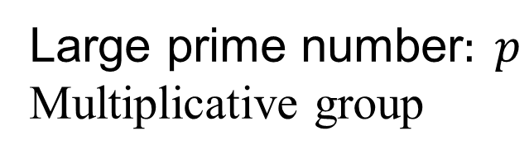
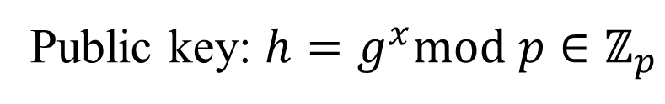
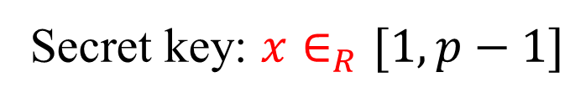
ElGamal cipher
ElGamal parameters
Large prime number$: p$
Multiplicative group
$$G=\left\langle g\right\rangle =ℤ_{p}\backslash \{0\}=\{1,2,…, p−1\}$$
Key generation (
Secret key: $x∈_{R}[1,p−1]$
Public key: $h=g^{x}mod p∈ℤ_{p}$
Notes:
The DSA is based on the difficulty of computing discrete logarithms (see Chapter 2)
and is based on schemes originally presented by Elgamal [ELGA85] and Schnorr
[SCHN91].
Figure 13.3 summarizes the algorithm.
There are three parameters that are public and can be common to a group of users. An N-bit prime number q is chosen. Next, a prime number p is selected with a length between 512 and 1024 bits such that q divides (p - 1). Finally, g is chosen to be of the form h^{(p-1)/q} mod p, where h is an integer between 1 and (p - 1) with the restriction that g must be greater than 1. Thus, the global public-key components of DSA are the same as in the Schnorr sig- nature scheme.
With these parameters in hand, each user selects a private key and generates a public key. The private key x must be a number from 1 to (q - 1) and should be chosen randomly or pseudorandomly. The public key is calculated from the private key as y = g^{x} mod p. The calculation of y given x is relatively straight- forward. However, given the public key y, it is believed to be computationally infeasible to determine x, which is the discrete logarithm of y to the base g, mod p (see Chapter 2).
The signature of a message M consists of the pair of numbers r and s, which are functions of the public key components (p, q, g), the user’s private key (x), the hash code of the message H(M), and an additional integer k that should be generated randomly or pseudorandomly and be unique for each signing.
Let M, r′, and s′ be the received versions of M, r, and s, respectively. Verification is performed using the formulas shown in Figure 13.3. The receiver generates a quantity v that is a function of the public key components, the sender’s public key, the hash code of the incoming message, and the received versions of r and s. If this quantity matches the r component of the signature, then the signature is validated.

Slide 24
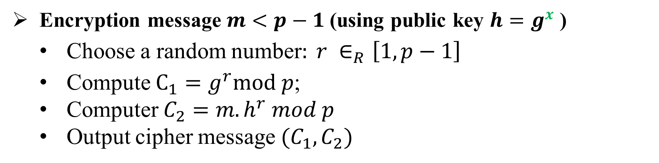
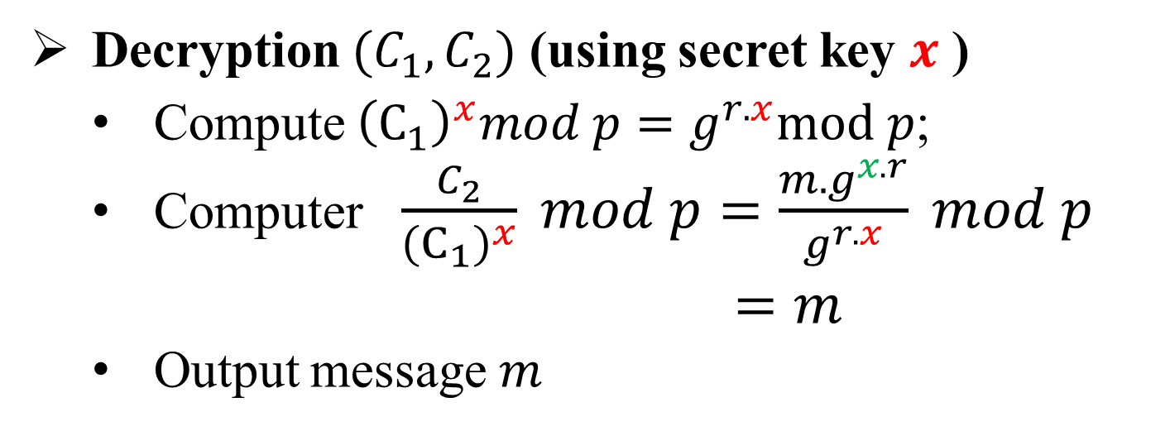
ElGamal cipher
Encryption message $m<p−1$(using public key $h=g^{x}$ )
Choose a random number$: r ∈_{R}\left[1,p−1\right]$
Compute $C_{1}=g^{r}mod p$;
Computer $C_{2}=m.h^{r} mod p$
Output cipher message $(C_{1},C_{2})$
Decryption $(C_{1},C_{2})$ (using secret key $x$ )
Compute ${\left(C_{1}\right)}^{x}mod p=g^{r.x}mod p$;
Computer $\frac{C_{2}}{{\left(C_{1}\right)}^{x}} mod p=\frac{m.g^{x.r}}{g^{r.x}} mod p$
$=m$
Output message $m$

Slide 25
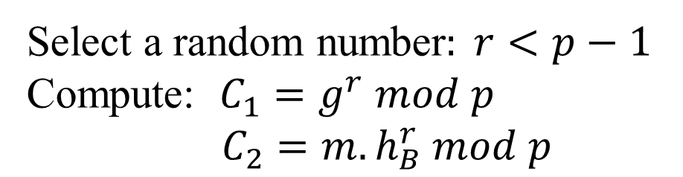
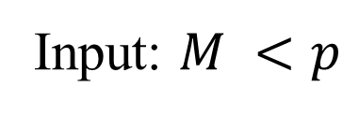

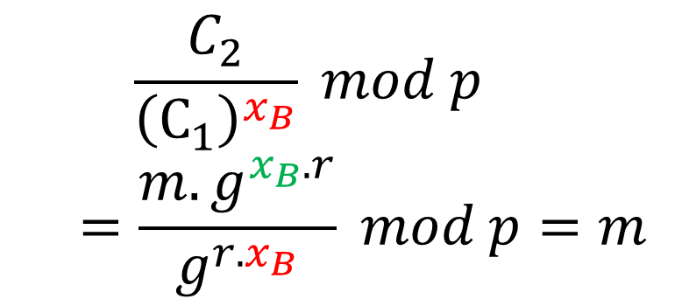

ElGamal cipher
A
public key
B
public key
?
public key
private key
$$PU_{B}=h_{B},p$$
$$(PR_{B}=x_{B}, PU_{B}={h_{B}=g}^{x_{B}},p)$$
Input: $M <p$
$${(C}_{1},C_{2})$$
Compute:
Select a random number$: r<p−1$
Compute: $C_{1}=g^{r} mod p$
$C_{2}=m.h_{B}^{r} mod p$
$$\frac{C_{2}}{{\left(C_{1}\right)}^{x_{B}}} mod p$$
$$=\frac{m.g^{x_{B}.r}}{g^{r.x_{B}}} mod p=m$$

Slide 26
Outline
Why asymmetric cryptography?
Factoring Based Cryptography (P1)
RSA signature;
Logarithm Based Cryptography (P2)
ElGamal cipher
Diffie-Hellman key exchange;
Elliptic Curve Cryptography (P3)
Some advanced cryptography system (quantum resistance)
Notes:
Cipher=a secret system of writing;

Slide 27
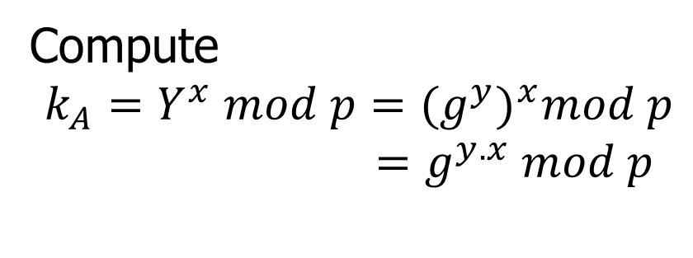

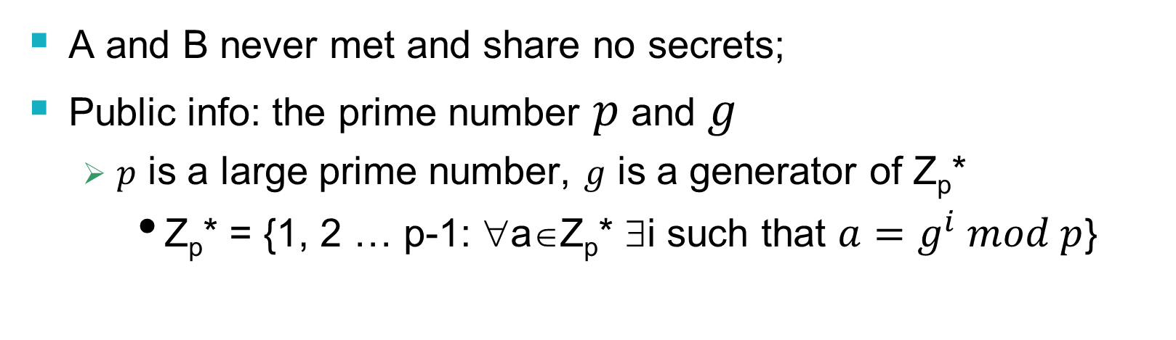

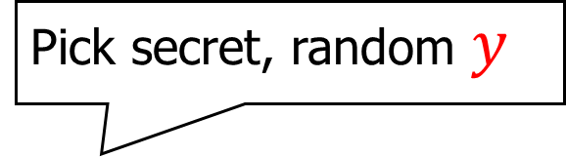
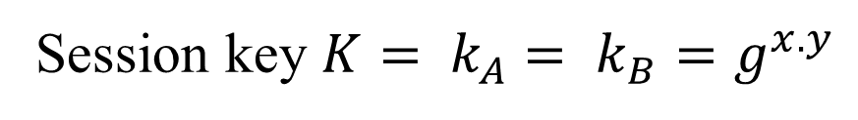
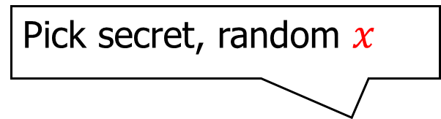
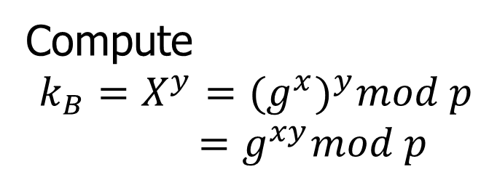
Diffie-Hellman key exchange
A and B never met and share no secrets;
Public info: the prime number $p$ and $g$
$p$ is a large prime number, $g$ is a generator of Z_{p}*
Z_{p}* = {1, 2 … p-1: ∀a∈Z_{p}* ∃i such that $a=g^{i} mod p$}
Pick secret, random $x$
Pick secret, random $y$
$$X=g^{x} mod p$$
A
$$Y=g^{y} mod p$$
B
Compute
$k_{A}=Y^{x} mod p={{(g}^{y})}^{x}mod p$
$=g^{y.x} mod p$
Compute
$k_{B}=X^{y}={(g^{x})}^{y}mod p$
$=g^{xy}mod p$
Session key $K= k_{A}$ $= k_{B}=g^{x.y}$
Symmetric key

Slide 28
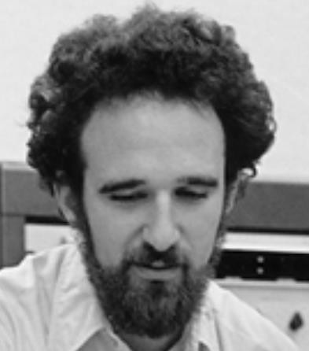
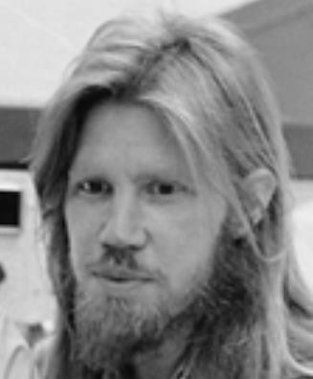


Diffie-Hellman exchange Protocol (DHE)
p = 1606938044258990275541962092341162602522202993782792835301301
𝑔 = 123456789
𝑔^{𝑎} mod p = 78467374529422653579754596319852702575499692980085777948593
𝑔^{𝑏} mod p =
560048104293218128667441021342483133802626271394299410128798
𝑎 =
685408003627063
761059275919665
781694368639459
527871881531452
𝑏 =
362059131912941
987637880257325
269696682836735
524942246807440
𝑔^{𝑎𝑏} mod p = 437452857085801785219961443000845969831329749878767465041215
${{(g}^{b})}^{a}$ $mod p$
$${{(g}^{a})}^{b}mod p$$

Slide 29
Why Is Diffie-Hellman Secure?
Discrete Logarithm (DL) problem:
given g^{x} mod p, it’s hard to extract x
There is no known efficient algorithm for doing this
This is not enough for Diffie-Hellman to be secure!
Computational Diffie-Hellman (CDH) problem:
given g^{x} and g^{y}, it’s hard to compute g^{xy} mod p
… unless you know x or y, in which case it’s easy
Decisional Diffie-Hellman (DDH) problem:
given g^{x} and g^{y}, it’s hard to tell the difference between g^{xy} mod p and g^{r} mod p where r is random

Slide 30
Properties of Diffie-Hellman
Assuming DDH problem is hard, Diffie-Hellman protocol is a secure key establishment protocol against passive attackers
Eavesdropper can’t tell the difference between the established key and a random value
Can use the new key for symmetric cryptography
Basic Diffie-Hellman protocol does not provide authentication
IPsec combines Diffie-Hellman with signatures, anti-DoS cookies, etc.

Slide 31











Man-in-the middle attacks the DHE
$$g^{a} mod p$$
$$(a,g^{a})$$
$$(b,g^{b})$$
$$g^{b} mod p$$
$$sk={{(g}^{b})}^{a}={{(g}^{a})}^{b}=g^{ab}mod p$$
B()
A(Putin)
man-in-the-middle attack!
$$g^{m} mod p$$
$$g^{a} mod p$$
$$g^{m} mod p$$
$$g^{b} mod p$$
$$sk_{1}=g^{am}mod p$$
$$sk_{2}=g^{bm}mod p$$

Slide 32
Advantages of Public-Key Crypto
Confidentiality without shared secrets
Very useful in open environments
Can use this for key establishment, avoiding the “chicken-or-egg” problem
With symmetric crypto, two parties must share a secret before they can exchange secret messages
Authentication without shared secrets
Encryption keys are public, but must be sure that Alice’s public key is really her public key
This is a hard problem… Often solved using public-key certificates

Slide 33
Disadvantages of Public-Key Crypto
Calculations are 2-3 orders of magnitude slower
Modular exponentiation is an expensive computation
Typical usage: use public-key cryptography to establish a shared secret, then switch to symmetric crypto
SSL, IPsec, most other systems based on public crypto
Keys are longer
3072 bits (RSA) rather than 128 bits (AES)
Relies on unproven number-theoretic assumptions
Factoring, RSA problem, discrete logarithm problem, decisional Diffie-Hellman problem…

